Slide 1
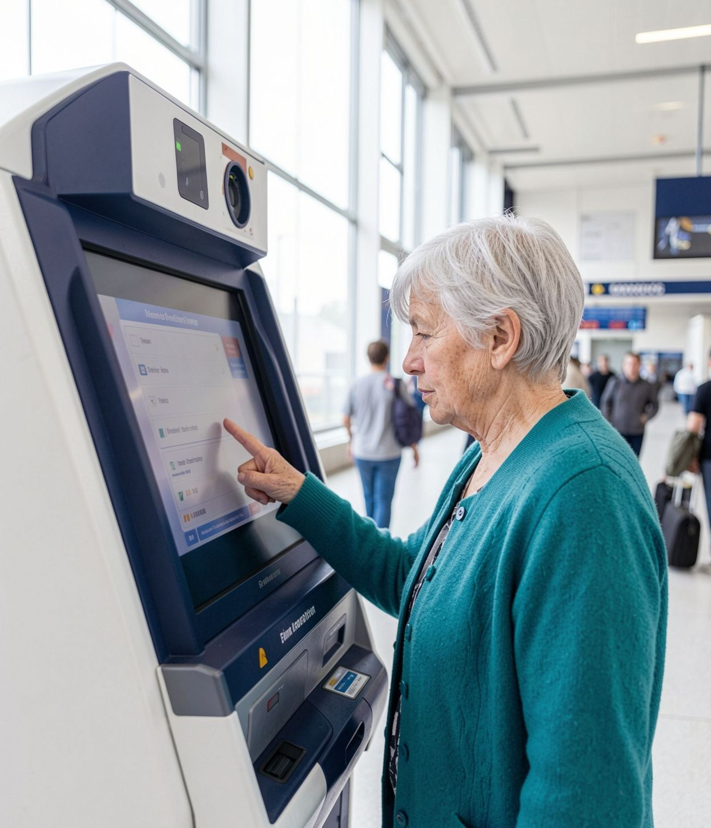
BUILD4BETTER · HACKATHON
KIOSK OF CONFIDENCE
Practice First. Use Technology Independently.
A safe interactive practice platform for confident self-service machine use.
Team: CSEnchronizers
Members: Mahnoor Awan, Sanaullah choohan,
zoha hasan, Ekta rani

Slide 2
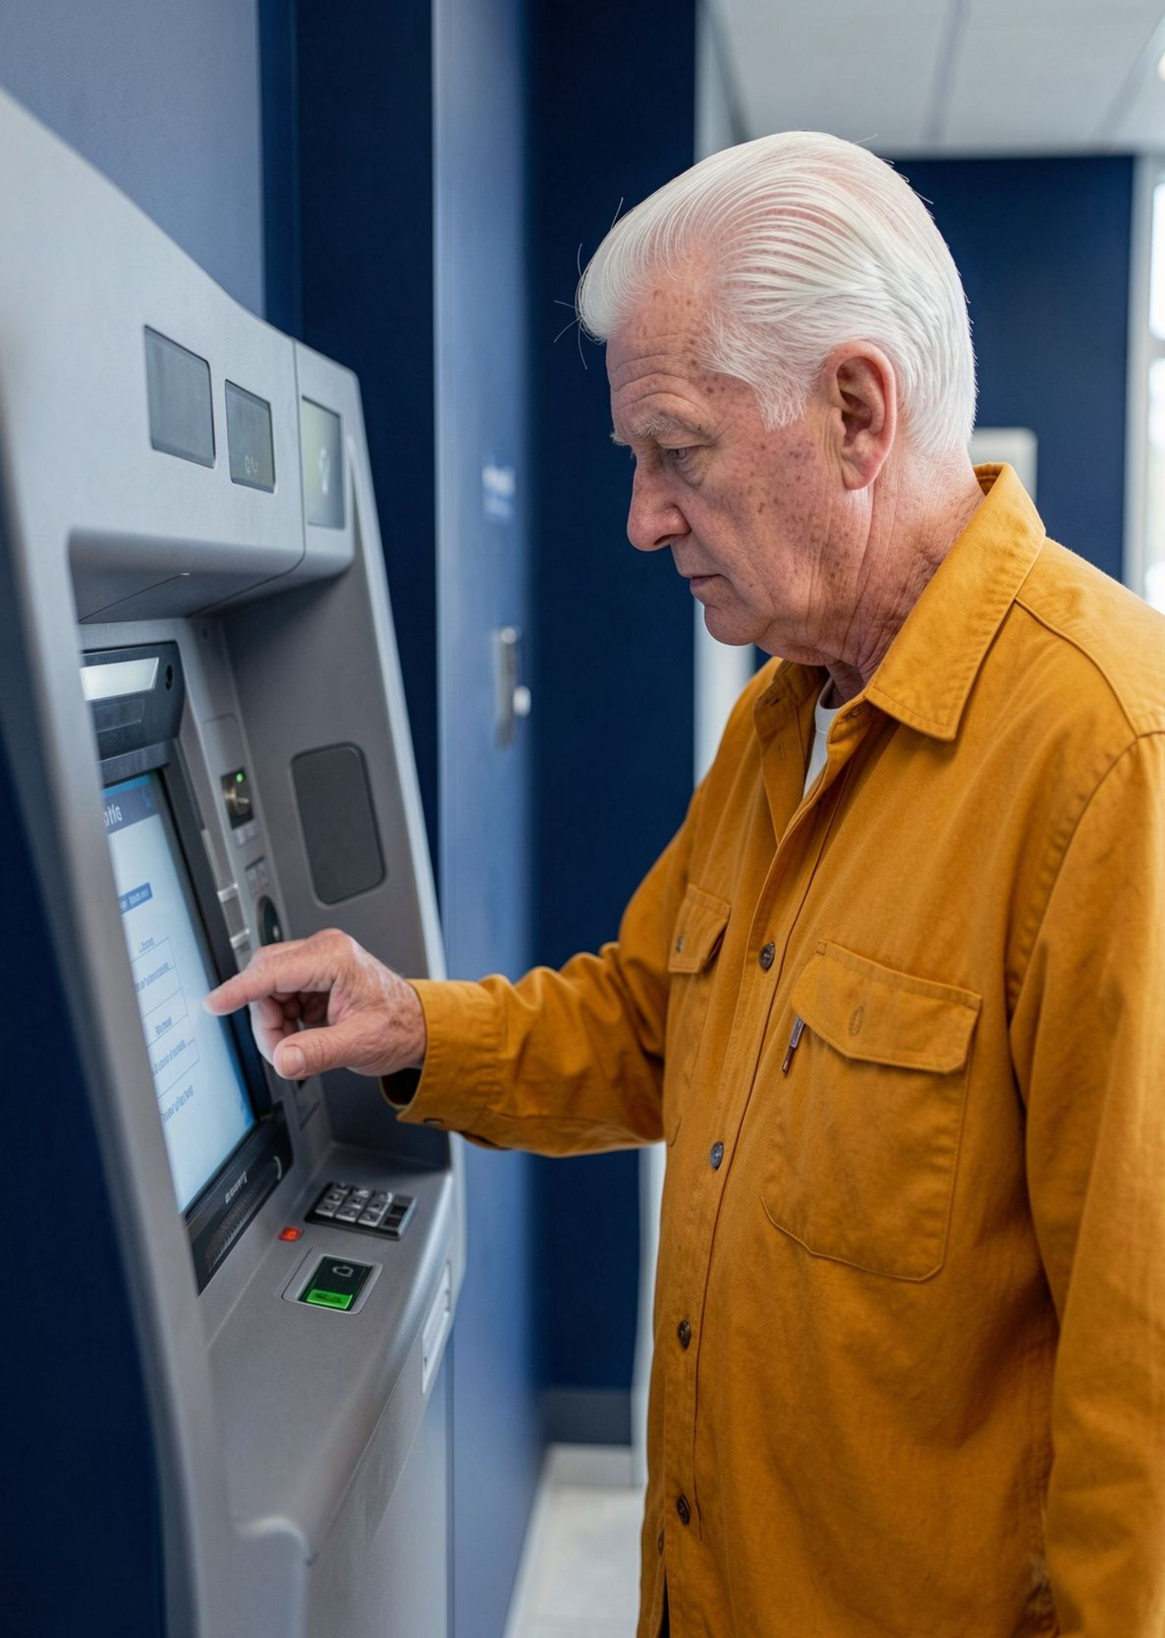
THE PROBLEM
Self-service is convenient — until confidence disappears
Unfamiliar touchscreens create confusion and fear of mistakes.
Multiple screens and instructions can overwhelm first-time users.
Older adults and nervous users may avoid the machine and rely on staff or family.
“What if I press the wrong button?”

Slide 3

TARGET USER
Who faces this problem?
Our target users are:
Older adults.
People with limited digital experience.
First-time users of self-service machines.
They need a safe way to understand technology before using it independently.

Slide 4





THE IDEA
Practice before the real-world moment
Kiosk of Confidence is a safe digital environment where users learn, practise, make mistakes, and build independence. Our goal is to help older adults and people with limited digital experience become more confident and independent when using everyday self-service machines.
Choose
Practise
Select a machine suited to needs
Perform the full task with support
Learn
Correct
Familiarize with the interface
Fix mistakes with guided tips

Slide 5
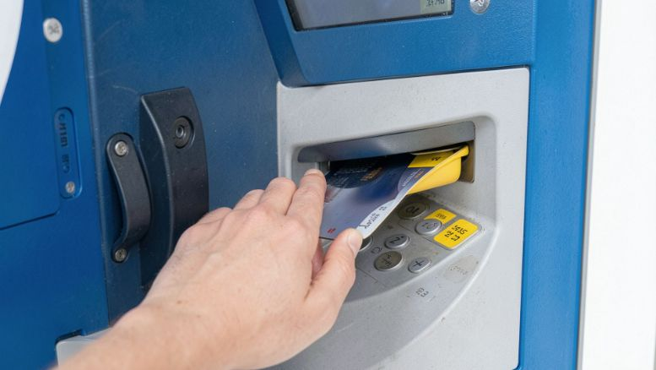
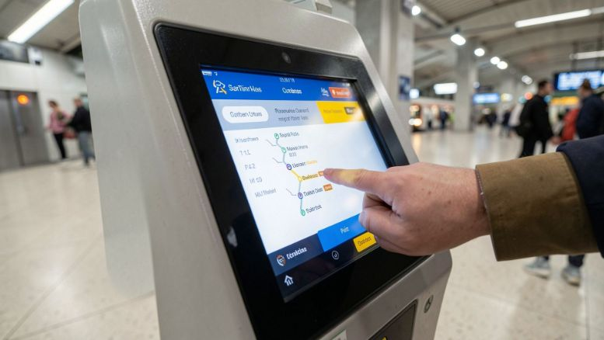
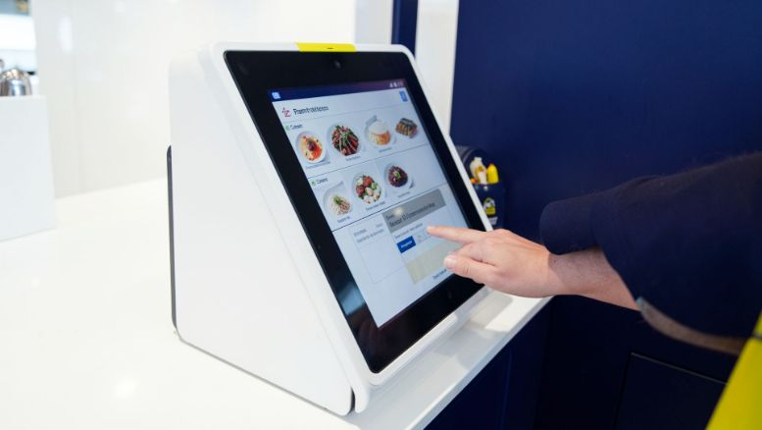
THE PLATFORM
One platform. Three everyday experiences.
ATM
Ticket booking
Food ordering
Withdraw cash, check a fictional balance, cancel transactions, and view simulated receipts.
Choose a route, ticket type, and passengers. Review, edit, and confirm a simulated booking.
Browse categories, customize items, edit quantities, review, and confirm a simulated order.

Slide 6
THE LEARNING LOOP
Learn. Practise. Become independent.
Each mode removes one layer of support while keeping the user in control.
1
2
3
Learn mode
Guided practice
Independent practice
Understand each screen and unfamiliar button.
Interact with hints when help is needed.
Repeat the task with fewer prompts and instructions.
Goal: gradual reduction of dependency

Slide 7






Designed for people, not just technology.
Readable by default
Language choice
Voice support
Large buttons and readable text reduce visual and motor effort.
Simple English and Urdu instructions make tasks easier to follow.
Voice instructions are available where browser support allows.
Help in context
Visible progress
Safe to repeat
Hints, help, back, edit, and cancel appear when they matter.
Progress indicators and completion feedback show what happens next.
Practice uses no real transactions, credentials, payments, or bookings.

Slide 8

THE PROTOTYPE
Simple technology. Safe learning.
The prototype keeps the experience focused: local simulation logic, clear learning guidance, and no connection to real financial or booking systems.
Open Web App
Select Simulator
Local Simulation
Complete Practice

Slide 9
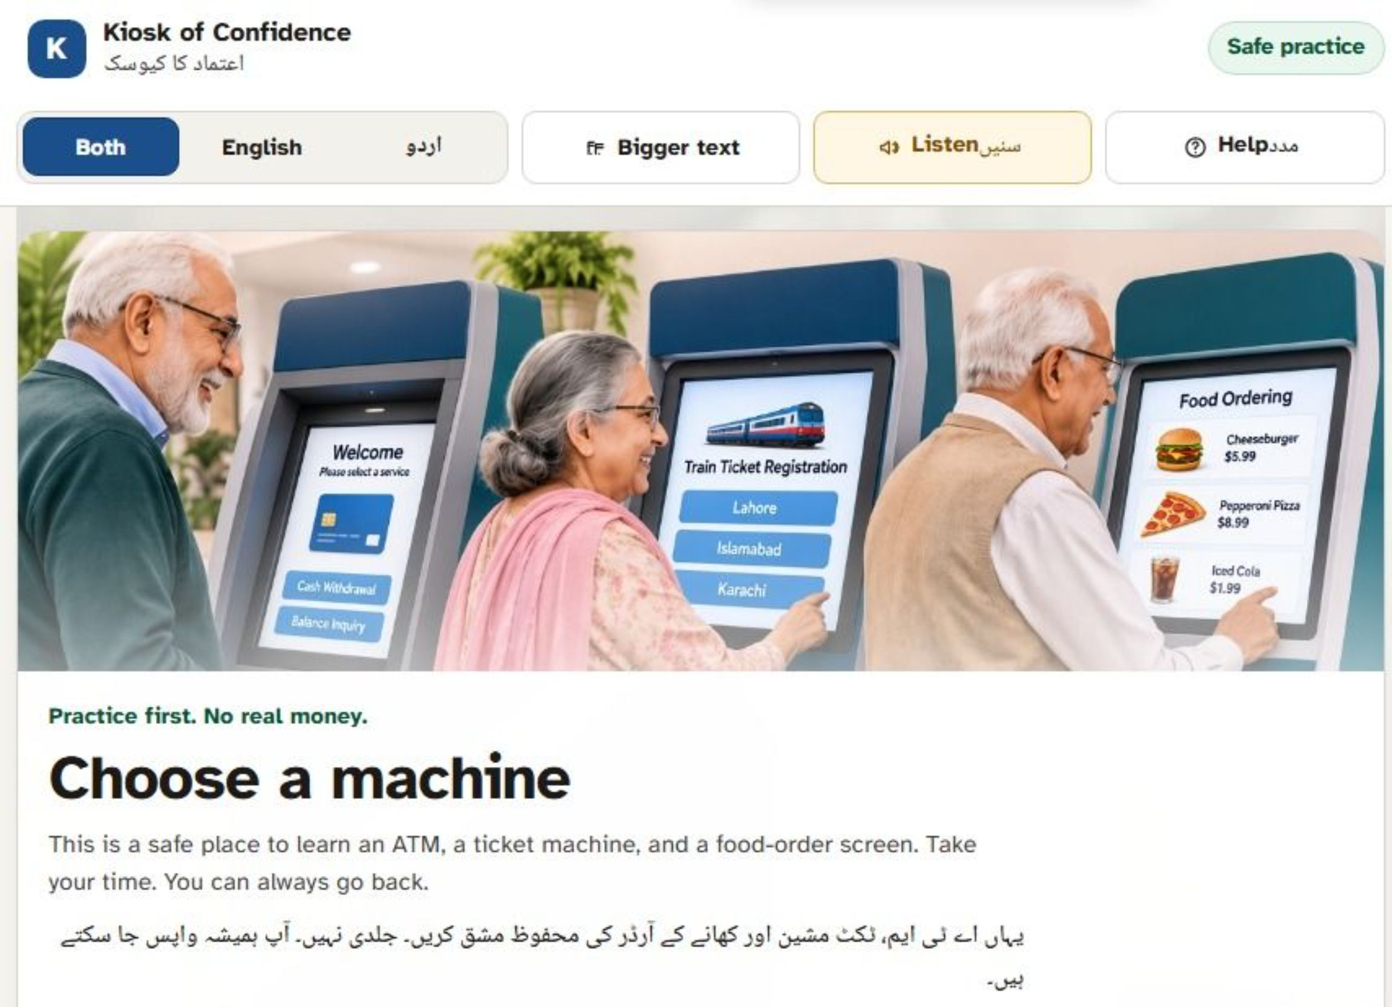
Live Demo Transition

Slide 10
Confidence is the first step toward digital independence.
“We don’t just teach people which buttons to press. We help them understand technology well enough to use it independently.”
Reduce fear of unfamiliar technology.
Support practice for everyday digital tasks.
Encourage independent use of self-service machines.
Make digital experiences more accessible through safe, repeatable learning.
Thank you — Team: [Team name] · GitHub: [Repository link] · Demo: [Project demo link]

